Slide 1
Activation Functions in Neural Networks

Slide 2
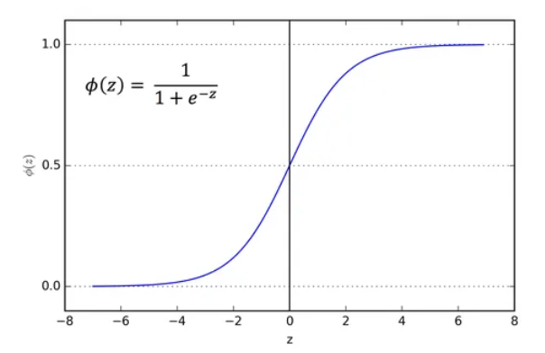
Activation Functions
What
Activation functions transform data to decides whether a neuron should be activated or not
The purpose of the activation function is to introduce non-linearity into the output of a neuron

Slide 3
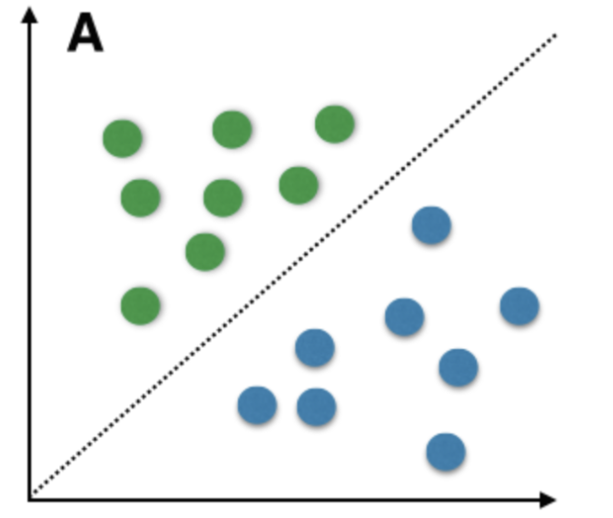
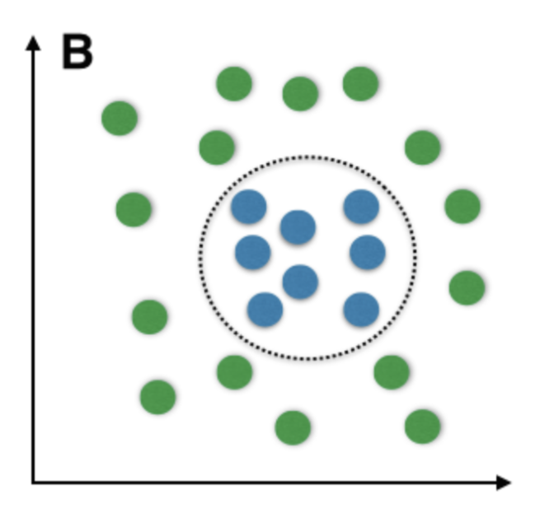


Activation Functions
What
Why
Why do we need Activation function
Linearly separable vs un-separable data
Real world data is linearly un-separable
$$Linearly separable data$$
L$inearly un−separable data$

Slide 4






Activation Functions
What
Why
Why do we need Activation function
Linearly separable vs un-separable data
Real world data is linearly un-separable
Activation function in Perceptron
x1
$$w1$$
∑(sum)
f
x2
$$w2$$
$$Y$$
$$Output$$
x3
$$w3$$
$$Z=x1w1+x2w2+x3w3$$

Slide 5



Activation Functions
What
Why
Why do we need Activation function
Linearly separable vs un-separable data
Real world data is linearly un-separable
Activation function in Perceptron
Activation function make NN more powerful and enable to learn complex and complicated data representation
x1
$$Linear$$
$$Non linear$$
∑(sum)
f(x)
x1
∑(sum)
f(x)
x1
$$Z=x1w1+x2w2+x3w3$$

Slide 6
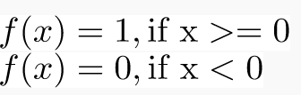
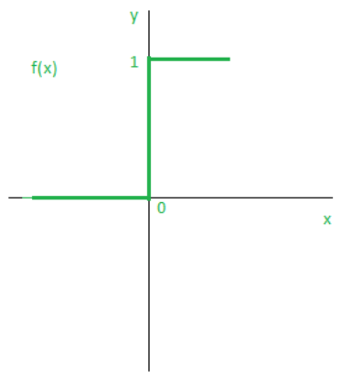
Activation Functions
What
Why
Step Activation
Step Activation function is the simplest activation function
The neuron is activated if the value is > 0 and deactivated if the value is < 0

Slide 7
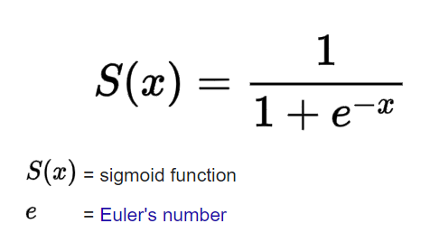
Activation Functions
What
Why
Step Activation
Sigmoid Activation
Sigmoid Activation function will scale the input between 0-1
Ex:
x=2 -> f(x) = 1/(1+e⁻²) = 0.88
x=-1 -> f(x) = 1/(1+e⁻²) = 0.27

Slide 8

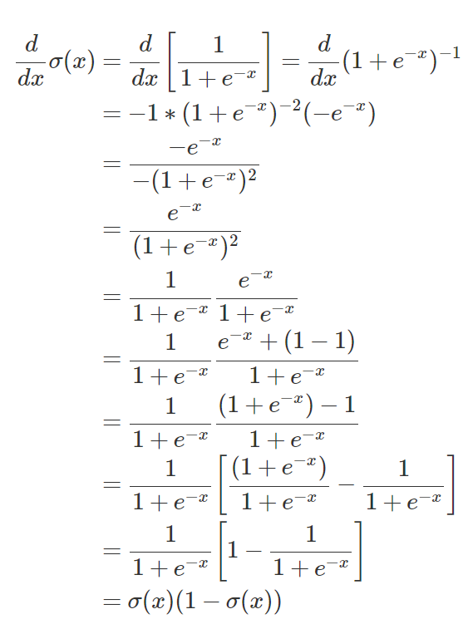
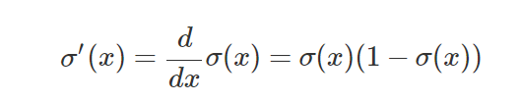
Activation Functions
What
Why
Step Activation
Sigmoid Activation
Sigmoid Activation function will scale the input between 0-1
Ex:
x=2 -> f(x) = 1/(1+e⁻²) = 0.88
x=-1 -> f(x) = 1/(1+e⁻²) = 0.27
Sigmoid Function derivative

Slide 9
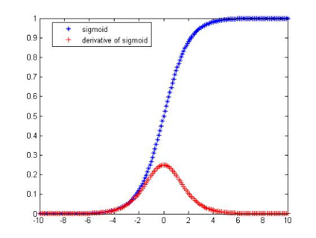
Activation Functions
What
Why
Step Activation
Sigmoid Activation
Sigmoid Activation function will scale the input between 0-1
Ex:
x=2 -> f(x) = 1/(1+e⁻²) = 0.88
x=-1 -> f(x) = 1/(1+e⁻²) = 0.27
Sigmoid Function derivative
Sigmoid derivative value is squashed between 0 to 0.25 for any value of y
This causes the problem of vanishing gradient in FFNN when used in multiple layers
Eg : 0.23 * 0.23 * 0.23 * 0.23 = 0.00279
Sigmoid function is typically used in the last layer of NN to squash values between 0 and 1

Slide 10

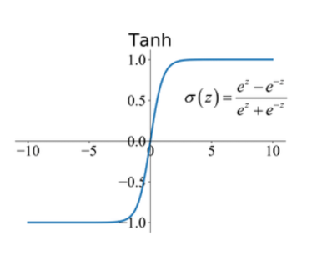
Activation Functions
What
Why
Step Activation
Sigmoid Activation
Tanh Activation
Tanh Activation function is a hyperbolic tangent function defined by
Tanh activation function will scale the input between -1 to 1
Ex:
f(0) -> 0
f(1) -> 0.761
F(-1.2) -> -0.42
Tanh function is zero centered and much better than sigmoid activation function

Slide 11
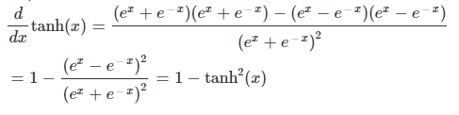

Activation Functions
What
Why
Step Activation
Sigmoid Activation
Tanh Activation
Tanh Activation function is a hyperbolic tangent function defined by
Tanh activation function will scale the input between -1 to 1
Ex:
f(0) -> 0
f(1) -> 0.761
F(-1.2) -> -0.42
Tanh function is zero centered and much better than sigmoid activation function
Derivative of Tanh is 1-tanh²(x)
$$Derivative of tanh$$

Slide 12
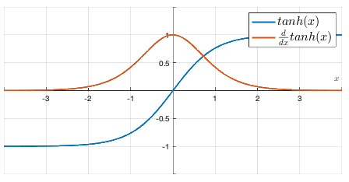
Activation Functions
What
Why
Step Activation
Sigmoid Activation
Tanh Activation
Tanh Activation function is a hyperbolic tangent function defined by
Tanh activation function will scale the input between -1 to 1
Ex:
f(0) -> 0
f(1) -> 0.761
F(-1.2) -> -0.42
Tanh function is zero centered and much better than sigmoid activation function
Derivative of Tanh is 1-tanh²(x)
The derivative of tanh is from 0 to 1, hence little better w.r.t vanishing gradient problem

Slide 13
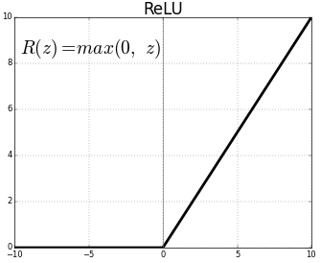
Activation Functions
What
Why
Sigmoid Activation
Tanh Activation
ReLU and PReLU
ReLU Activation Function – Rectified Linear Unit
R(z) = max(0, z)

Slide 14

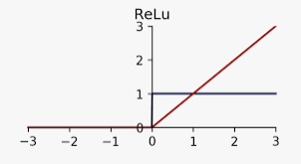

Activation Functions
What
Why
Sigmoid Activation
Tanh Activation
ReLU and PReLU
ReLU Activation Function – Rectified Linear Unit
R(z) = max(0, z)
Derivative of ReLU
Problem – if input is negative, the derivative output is 0 and the gradient will die
$$Derivative of ReLU$$

Slide 15

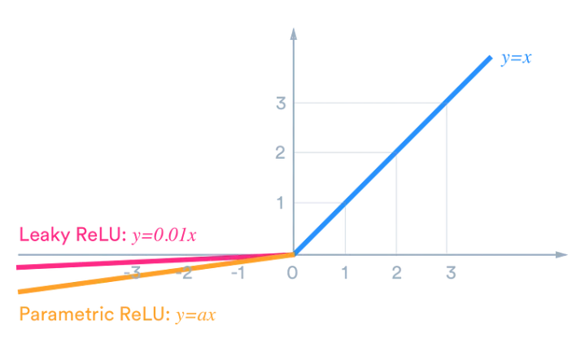

Activation Functions
What
Why
Step Activation
Sigmoid Activation
Tanh Activation
ReLU and PReLU
ReLU Activation Function – Rectified Linear Unit
R(z) = max(0, z)
Derivative of ReLU
Problem – if input is negative, the derivative output is 0 and the gradient will die
Parametric ReLU and Leaky ReLU
α is a learnable parameter
$$PReLU$$

Slide 16


Activation Functions
What
Why
Step Activation
Sigmoid Activation
Tanh Activation
ReLU and PReLU
ReLU Activation Function – Rectified Linear Unit
R(z) = max(0, z)
Derivative of ReLU
Problem – if input is negative, the derivative output is 0 and the gradient will die
Parametric ReLU and Leaky ReLU
Derivative of PReLU
PReLU solves the dying ReLU problem
$$Derivative of PReLU$$

Slide 17

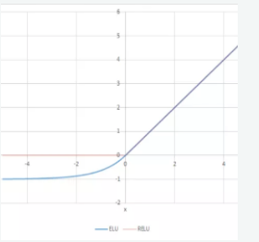

Activation Functions
What
Why
Step Activation
Sigmoid Activation
Tanh Activation
ReLU and PReLU
Exponential LU(ELU)
Exponential Linear Unit is an activation function defined by
For negative values, we have exponential curve rather than a flat curve
$$ELU$$

Slide 18
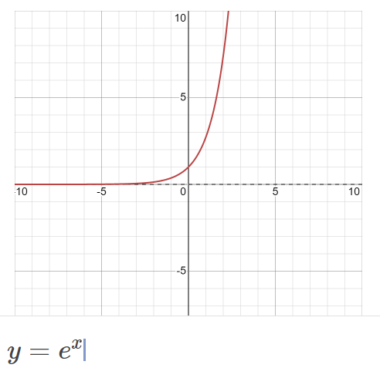
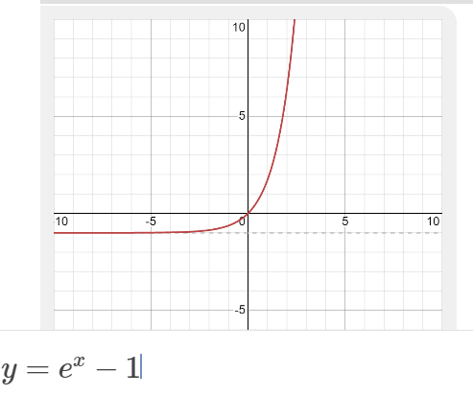
Activation Functions
What
Why
Sigmoid Activation
Tanh Activation
ReLU and PReLU
Exponential LU(ELU)
Exponential Linear Unit is an activation function defined by
For negative values, we have exponential curve rather than a flat curve
Why exp(x) – 1 ?

Slide 19


Activation Functions
What
Why
Step Activation
Sigmoid Activation
Tanh Activation
ReLU and PReLU
Exponential LU(ELU)
Exponential Linear Unit is an activation function defined by
For negative values, we have exponential curve rather than a flat curve
Why exp(x) – 1 ?
Derivative of ELU
$$Derivative of ELU$$

Slide 20
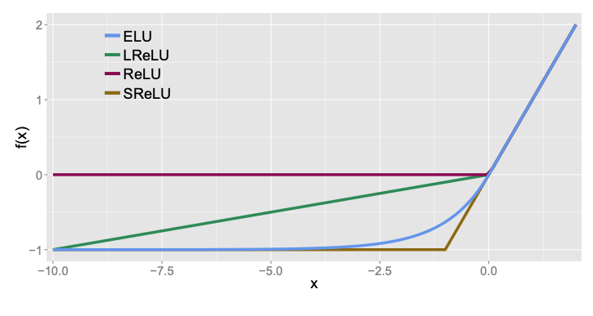
Activation Functions
What
Why
Step Activation
Sigmoid Activation
Tanh Activation
ReLU and PReLU
Exponential LU(ELU)
Exponential Linear Unit is an activation function defined by
For negative values, we have exponential curve rather than a flat curve
Why exp(x) – 1 ?
Derivative of ELU
Comparison between Linear Unit activation functions

Slide 21
Thank You

